Slide 1
Hierarchical Clustering
By
Dr. S PADMANABHAN

Slide 2
Hierarchical Clustering
Hierarchical clustering is another unsupervised machine learning algorithm, which is used to group the unlabeled datasets into a cluster and also known as hierarchical cluster analysis or HCA.
In this algorithm, we develop the hierarchy of clusters in the form of a tree, and this tree-shaped structure is known as the dendrogram.
Sometimes the results of K-means clustering and hierarchical clustering may look similar, but they both differ depending on how they work. As there is no requirement to predetermine the number of clusters as we did in the K-Means algorithm.

Slide 3
Why hierarchical clustering?
We can opt for the hierarchical clustering algorithm because, in this algorithm, we don't need to have knowledge about the predefined number of clusters.

Slide 4
Hierarchical Clustering
The hierarchical clustering technique has two approaches:
Agglomerative: Agglomerative is a bottom-up approach, in which the algorithm starts with taking each data points as a unique cluster and merging them until a single cluster is formed.
Divisive: Divisive algorithm is the reverse of the agglomerative algorithm as it is a top-down approach.

Slide 5
Agglomerative Hierarchical clustering
The agglomerative hierarchical clustering algorithm is a popular example of HCA. To group the datasets into clusters, it follows the bottom-up approach. It means, this algorithm considers each datapoint as a single cluster at the beginning, and then start combining the closest pair of clusters together. It does this until all the clusters are merged into a single cluster that contains all the datasets.
This hierarchy of clusters is represented in the form of the dendrogram.

Slide 6
Agglomerative clustering - Procedure
Step-1: Consider each observation as a unique cluster
Step-2: Calculate the pairwise distance between all the clusters
Step-3: Combine the two nearest clusters into a single cluster
Step-4: Calculate the distance between newly formed cluster and the remining clusters.
Step-5: Repeat the steps-3 and 4, until a single cluster is formed.

Slide 7
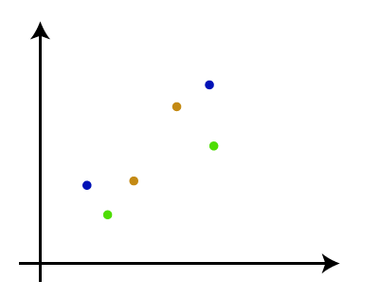
How the Agglomerative Hierarchical clustering Work?
The working of the AHC algorithm can be explained using the below steps:
Step-1: Consider each data point as a single cluster. Let's say there are N data points, so the number of clusters will also be N.

Slide 8
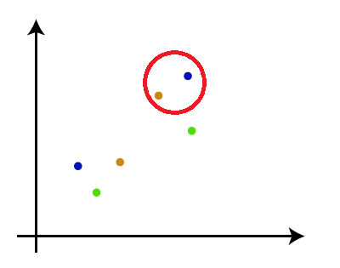
Step-2: Take two closest data points or clusters and merge them to form one cluster. So, there will now be N-1 clusters.

Slide 9
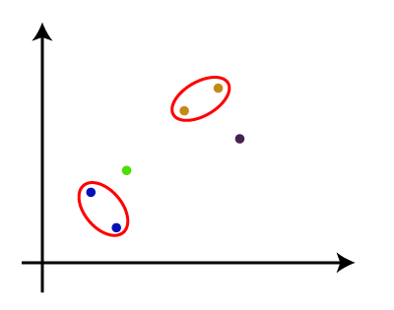
Step-3: Again, take the two closest clusters and merge them together to form one cluster. There will be N-2 clusters.

Slide 10
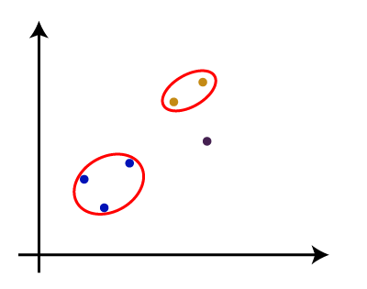
Step-4: Repeat Step 3 until only one cluster left. So, we will get the following clusters. Consider the below images:

Slide 11
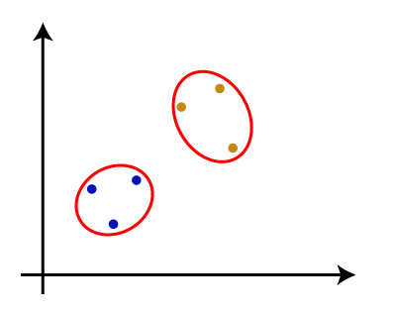

Slide 12
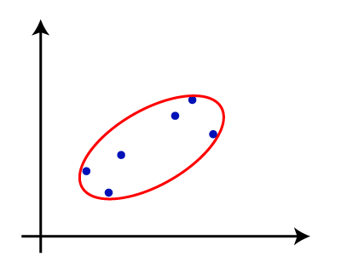
Step-5: Once all the clusters are combined into one big cluster, develop the dendrogram to divide the clusters as per the problem.

Slide 13
Measure for the distance between two clusters
As we have seen, the closest distance between the two clusters is crucial for the hierarchical clustering. There are various ways to calculate the distance between two clusters, and these ways decide the rule for clustering. These measures are called Linkage methods. Some of the popular linkage methods are :
Single Linkage
Complete Linkage
Average Linkage
Centroid Linkage
Ward Linkage

Slide 14

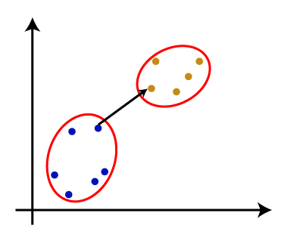
1. Single Linkage:
It is defined as the minimum distance between the points of two clusters.
It is the Shortest Distance between the closest points of the clusters. Consider the below image:

Slide 15

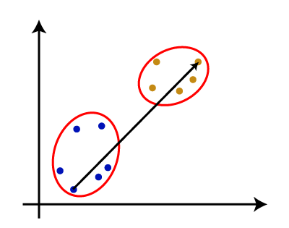
2. Complete Linkage:
It is defined as the maximum distance between the points of the two different clusters
It is the farthest distance between the two points of two different clusters. It is one of the popular linkage methods as it forms tighter clusters than single-linkage.

Slide 16

3. Average Linkage:
It is defined as the average of all the pairwise distances between the two clusters.
It is the linkage method in which the distance between each pair of datasets is added up and then divided by the total number of datasets to calculate the average distance between two clusters. It is also one of the most popular linkage methods.

Slide 17
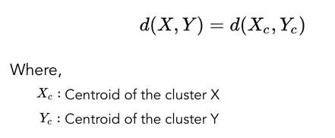
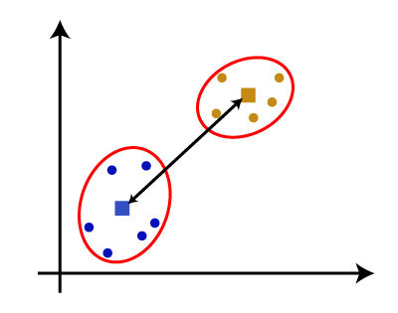
4. Centroid Linkage
It is defined as the distance between the centroids (means) of the two clusters.

Slide 18
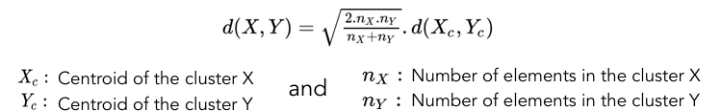
5. Ward Linkage
Ward linkage, also known as Ward’s method, is a criterion used in hierarchical clustering to minimize the variance within clusters.
It is a computationally intensive method
It is given by the formula:

Slide 19
Problem: Say the distance between cluster B and A is 4, and the distance between C and A is 6. What is the distance between the cluster (BC) and A using complete and single linkage methods?
Single Linkage Method
In the single linkage method, the distance between two clusters is defined as the minimum distance between any single member of one cluster and any single member of the other cluster.
Given: d (B, A) = 4 and d (C, A) = 6
For single linkage method: d (BC, A) = min {d (B, A), d (C, A)}
= min {4, 6} = 4

Slide 20
Complete Linkage Method
In the complete linkage method, the distance between two clusters is defined as the maximum distance between any single member of one cluster and any single member of the other cluster.
Given: d (B, A) = 4 and d (C, A) = 6
For complete linkage method: d (BC, A) = max {d (B, A), d (C, A)}
= max {4, 6} = 6
Single Linkage Method: d (BC, A) = 4
Complete Linkage Method: d (BC, A) = 6

Slide 21
Working of Dendrogram in Hierarchical clustering
The dendrogram is a tree-like structure that is mainly used to store each step as a memory that the HC algorithm performs. In the dendrogram plot, the Y-axis shows the Euclidean distances between the data points, and the x-axis shows all the data points of the given dataset.

Slide 22
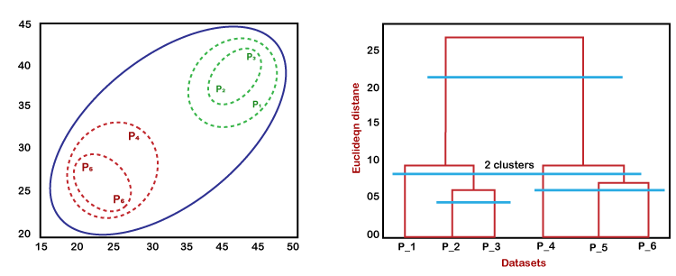
The working of the dendrogram can be explained using the below diagram:

Slide 23
In the above diagram, the left part is showing how clusters are created in agglomerative clustering, and the right part is showing the corresponding dendrogram.
As we have discussed above, firstly, the datapoints P2 and P3 combine together and form a cluster, correspondingly a dendrogram is created, which connects P2 and P3 with a rectangular shape. The Hight is decided according to the Euclidean distance between the data points.
In the next step, P5 and P6 form a cluster, and the corresponding dendrogram is created. It is higher than of previous, as the Euclidean distance between P5 and P6 is a little bit greater than the P2 and P3.

Slide 24
Again, two new dendrograms are created that combine P1, P2, and P3 in one dendrogram, and P4, P5, and P6, in another dendrogram.
At last, the final dendrogram is created that combines all the data points together.
We can cut the dendrogram tree structure at any level as per our requirement.

Slide 25
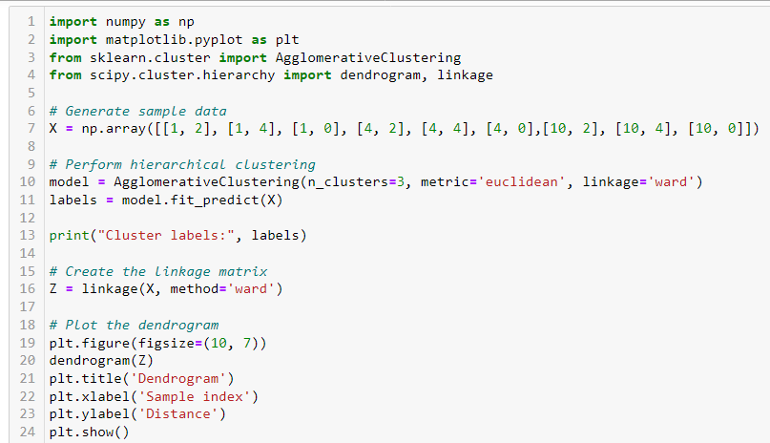
Python code

Slide 26
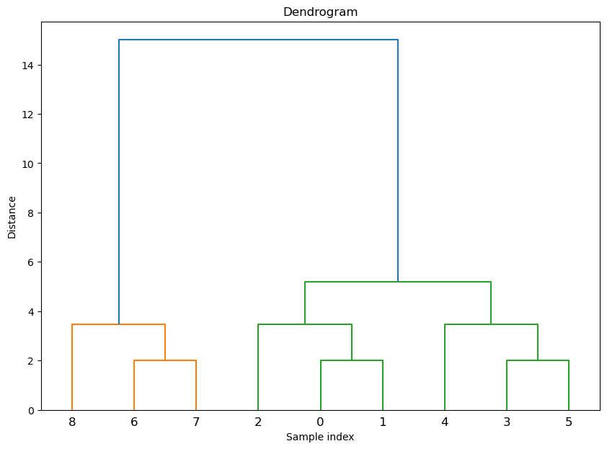
Python code

Slide 27
Cophenetic correlation coefficient
The Cophenetic Correlation Coefficient (CPCC) is a measure used in hierarchical clustering to evaluate how well the dendrogram (a tree-like diagram) represents the pairwise distances between the original data points.
Faithfulness of Representation: The CPCC quantifies how faithfully the dendrogram preserves the original pairwise distances among the data points. A higher CPCC value indicates that the dendrogram is a good representation of the data.

Slide 28
Cophenetic correlation coefficient
Calculation: To compute the CPCC, we need two matrices:
The distance matrix: This contains the original pairwise distances between data points.
The cophenetic matrix: This contains the cophenetic distances, which are the heights at which pairs of data points are first joined together in the dendrogram.
The CPCC is the correlation coefficient between these two matrices.
A CPCC close to 1 suggests that the hierarchical clustering structure is a good fit for the data, meaning the clustering process has effectively captured the inherent structure of the data

Slide 29
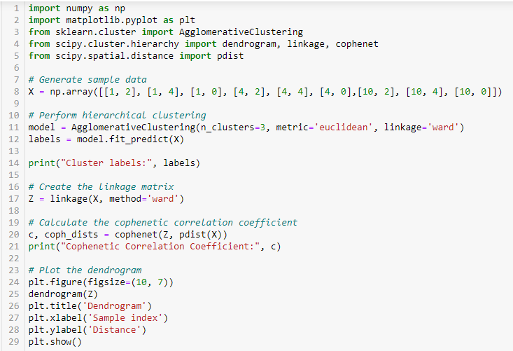
Python code

Slide 30


Slide 31
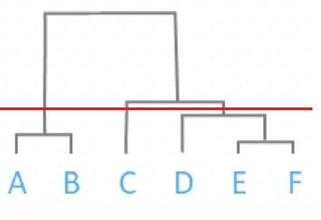
Problem:
How many clusters can be formed for the following dendrogram with respect to the distance marked as a redline. Also write the samples name exist in each cluster.

Slide 32
Based on the dendrogram and the red line marking the distance:
Number of Clusters: 3 clusters
Clusters and Samples:
Cluster 1: A, B
Cluster 2: C
Cluster 3: D, E, F
The red line intersects the dendrogram at a point that divides the samples into these three clusters.

Slide 33
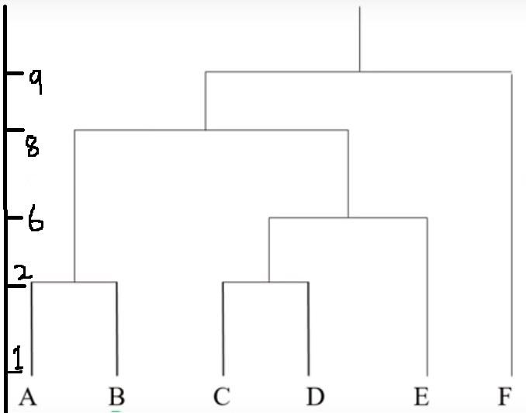
Problem:
Compute the optimal number of clusters for the below dendrogram? What are all the observations (samples) present in each cluster?

Slide 34
To determine the optimal number of clusters from the dendrogram and identify the samples in each cluster, follow these steps:
Draw a Horizontal Line: Identify the largest vertical distance that doesn’t cross any horizontal lines. Draw a horizontal line at this point.
Count Intersections: Count the number of vertical lines that intersect with the horizontal line. Each intersection represents a cluster.

Slide 35
Distance between 2 and 6 is more. Draw a horizontal line between 2 and 6

Slide 36
Analysis of the Provided Dendrogram:
Optimal Number of Clusters: 4 clusters
Clusters and Samples:
Cluster 1: A, B
Cluster 2: C, D,
Cluster 3: E
Cluster 4: F
The horizontal red line intersects four vertical lines, indicating four clusters. The samples in each cluster are grouped based on their connections below the red line.

